Slide 2
2019 Rule Amendment Proposals
Presented by ICAOS Rules Committee Members:
Doug Clark (Chair, SD) Dori Littler (Vice-chair, AZ) Joselyn López (WI) Margaret Thompson (PA)
& Tracy Hudrlik (MN)

Slide 3
Rules Committee Membership
Commissioners
Doug Clark, SD Chair
Dori Littler, AZ Vice Chair
Chris Moore, GA
Robert Maccarone, NY
Joe Winkler, FL
Linda Rosenburg, PA
Joselyn Lopez, WI
Brody Burk, TX
ExOfficio
Margaret Thompson, PA
Tim Strickland, FL
Tracy Hudrlik, MN
Pat Odell, WY

Slide 4
Rules Committee
Proposals referred from:
Majority of Commissioners at ABM
Region
Standing Committee
Provide draft to all Commissioners for review and comment (post on ICAOS website)
Prepare final draft, based on comments;

Slide 5
Adoption of Rules
Submit to Commission for consideration “not later than the next annual meeting falling in an odd-numbered year”
Publish text and notice of public hearing, not later than 30 days prior to scheduled vote
Interstate Commission shall take final action on the proposal by a majority vote of yes/no.

Slide 6
Idea for Rule or Amendment?
Not sure where to start?
Rules Proposal Guide provides draft template and outlines ICAOS’s rule/amendment adoption process from draft to final action
https://www.interstatecompact.org/sites/default/files/pdf/meetings/rules/ICAOS-Rule-Proposal-Guide.pdf
Notes:
Available for download from rules committee page on icaos website.

Slide 7
Summary of 2019 Proposals
ByLawArt2Sect2 (Executive Committee)
Rules 1.101 ‘Abscond’ & 4.109 (Midwest Region)
Rules 1.101 ‘Sex Offender,’ 3.101-3 and 3.107 (Rules Committee)
Rules 1.101 ‘Temporary Travel Permit,’ ‘Victim Sensitive,’ 3.108, 3.108-1, 3.110*NEW RULE & 4.111 (Rules Committee) 3 VOTES!
Rule 3.101-1 (West Region) 2 VOTES!
Notes:
Note, the sex offender will go last to include info related to Pakingham decision.

Slide 8
Summary of 2019 Proposals
Rule 3.103 (West Region)
Rule 4.106 (West Region)
Rule 4.111(Midwest Region)
Rule 5.101 (West Region)
Rule 5.103 (West Region)
Rule 5.103-1 (West Region)
Effective date for rules will be APRIL 1, 2020
Amendment to by-law will be effective immediately

Slide 9
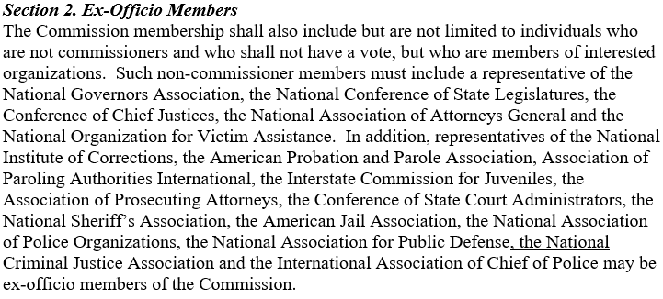
BylawArt2Sec2 (Executive Committee)

Slide 10
BylawArt2Sec2 (Executive Committee)
Expands ex-officio organizations to include NCJA

Slide 11
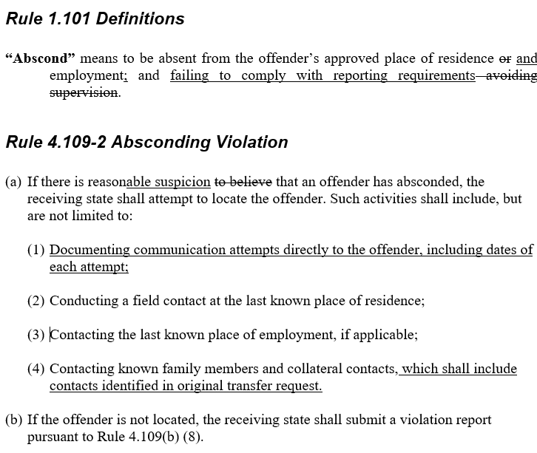
Rules 1.101 ‘Abscond’ & 4.109 (Midwest Region)

Slide 12
Better defines term ‘reason to believe’
Ensures adequate documentation is reported to the sending state
Identifies individuals noted in original transfer request that should be contacted
IMPACT
ICOTS: YES $2,850
Rule/Opinion: None
Rule Committee Action
Recommends to Adopt
Rules 1.101 ‘Abscond’ & 4.109 (Midwest Region)

Slide 13
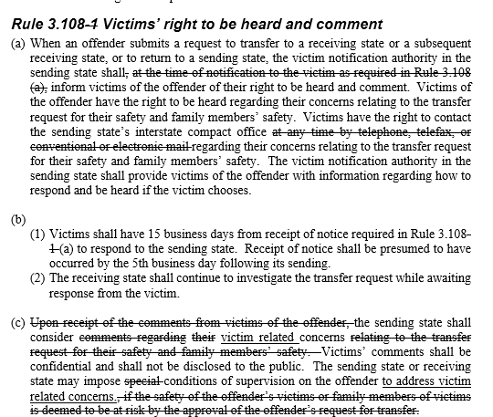
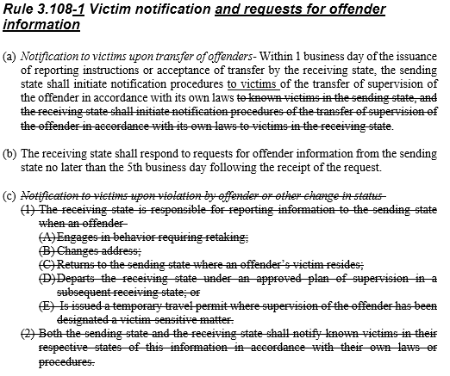
Victim Rules Package Proposal

Slide 14
Discussion included:
The 2018 ABM decision to discontinue the use of IVINS
The 2018 IVINS Survey Results
How the current rules fit in with the purpose of the Compact
IMPACT
ICOTS: TBD by Commission Vote $18,015
Rule/Opinion: None
Rule Committee Action
Recommends to Adopt
3 Separate Votes
Other Rules in Package (1.101, 3.108, 3.108-1, 4.111
New Rule 3.110 Travel Permits
ICOTS impact to remove ‘Victim Sensitive’ indicator
Victim Rules Package Proposal

Slide 15
Rules 1.101, 3.108, 3.108-1 &4.111
Strike definitions of “Victim sensitive” and “Temporary travel permit” as revised rules no longer use definitions
3.108 & 3.108-1 (Switch rule numbers)
Simplify and clean up antiquated language such as use of the word ‘telefax’
3.108-1 new title Victim notification and requests for offender information
Victim Rules Package Proposal

Slide 16
Rules 1.101, 3.108, 3.108-1 &4.111
Notifications to the sending states outlined in 3.108 (b) are not necessary since they are already provided in ALL cases under separate existing rules (with the exception of travel permits-to be addressed w/New Rule 3.110)
Clarification to the Commission that the sending state is responsible for notifying victims, 4.111 (e) is no longer necessary
Victim Rules Package Proposal

Slide 17
ICOTS Impact for Victim Rules
SEPARATE
VOTE!!
$18,015 to remove ‘victim sensitive’ indicator in ICOTS
Comments indicate support for rule changes w/ reservations about taking the indicator out
Most states DO NOT utilize the ‘victim sensitive’ indicator consistently as currently defined
A few states note they find benefit using the indicator internally
Other ICOTS management features exist w/o a governing rule associated
Victim Rules Package Proposal

Slide 18
New Rule 3.110 Travel Permits
SEPARATE
VOTE!!
Victim Rules Package Proposal

Slide 19
New Rule 3.110 Travel Permits
SEPARATE
VOTE!!
Addresses removal of 3.108 (b)(1)(E) in current rules
Better equips sending state w/ victim notification when offender is traveling back to a sending state
Notification is not required for known travel for employment or medical appointments
Victim Rules Package Proposal

Slide 20
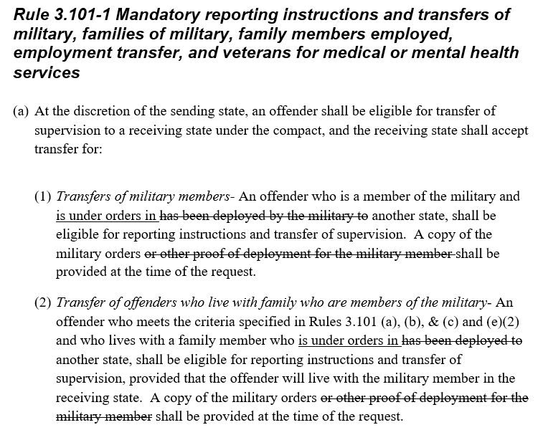
Rule 3.101-1 (a) (1) & (2) (West Region)

Slide 21
Replace ‘deployed’ with ‘under orders’
Consist with terms used by the military
IMPACT
ICOTS: No
Rule/Opinion: None
Rule Committee Action
Recommends to Adopt
Rule 3.101-1 (a) (1) & (2) (West Region)

Slide 22
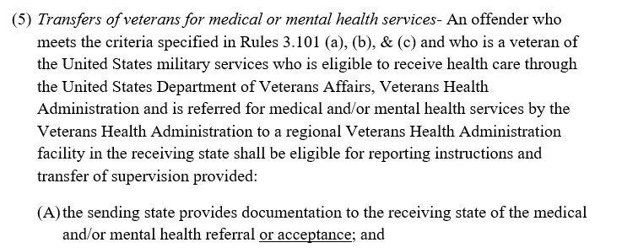
Rule 3.101-1 (e) (West Region)

Slide 23
Ensures the rule applies to those ‘acceptance’ in addition to being ‘referred’ for treatment
Streamlines the referral and acceptance process for VA treatment
IMPACT
ICOTS: No
Rule/Opinion: None
Rule Committee Action
Recommends to Adopt
Rule 3.101-1 (e) (West Region)

Slide 24
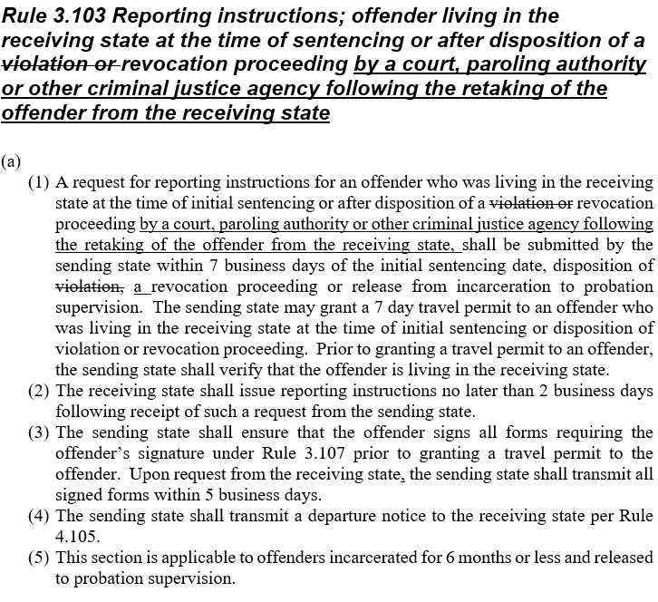
Rule 3.103 (West Region)

Slide 25
Requires that a revocation proceeding, not just a violation disposition, must take place and must be heard by a formal authority of a court or paroling authority
Ensures retaking must have occurred prior to the proceeding
IMPACT
ICOTS: Yes TBD
Rule/Opinion: None
Rule Committee Action
Recommends to Adopt
Rule 3.103 (West Region)

Slide 26
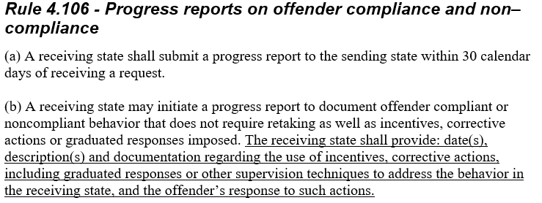
Rule 4.106 (West Region)

Slide 27
Mandates the same documentation requirements for progress reports just as it is for violation reports requiring retaking
IMPACT
ICOTS: Yes $4,155
Rule/Opinion: None
Rule Committee Action
Recommends to Adopt
Rule 4.106 (West Region)

Slide 28
Rule 4.111 (Midwest Region)

Slide 29
Aligns Rule 4.111(a) and Rule 5.101-1 so that the language matches in regards to eligible returns
IMPACT
ICOTS: No
Rule/Opinion: None
Rule Committee Action
Recommends to Adopt
Rule 4.111 (Midwest Region)

Slide 30
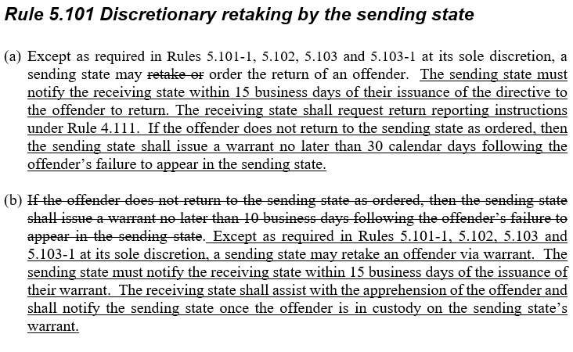
Rule 5.101 (West Region)

Slide 31
Establishes timeframes and tracking for offenders retaken by the sending state at its discretion
IMPACT
ICOTS: No
Rule/Opinion: None
Rule Committee Action
Recommends to Adopt
Rule 5.101 (West Region)

Slide 32
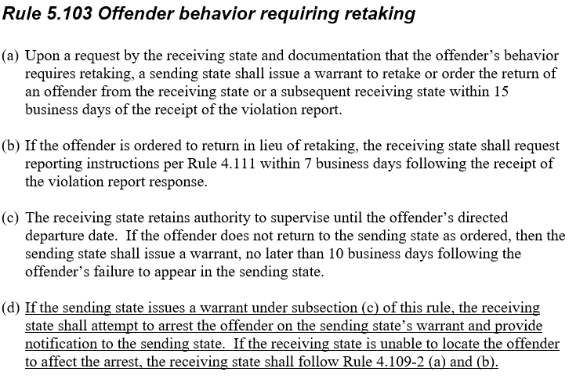
Rule 5.103 (West Region)

Slide 33
Clarifies the receiving state’s responsibility to arrest an offender subject to retaking
When offenders are not located receiving states should be attempting to locate the offender as an absconder under Rule 4.109-2
IMPACT
ICOTS: TRAINING ONLY-States should use ADDENDUMS to report on custody status
Rule/Opinion: None
Rule Committee Action
Recommends to Adopt
Rule 5.103 (West Region)

Slide 34
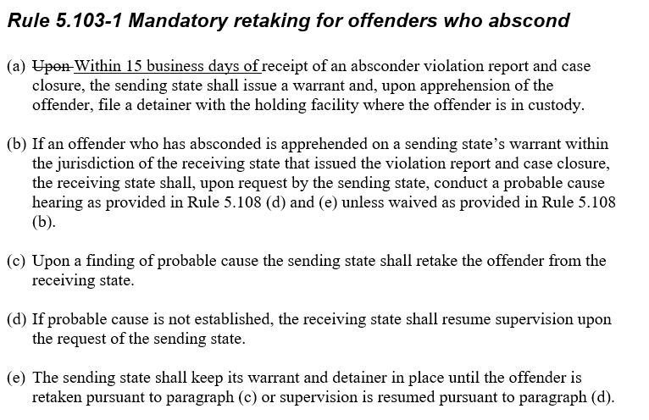
Rule 5.103-1 (West Region)

Slide 35
“Upon receipt” is open to interpretation (particularly for probation cases)
Establishes a timeframe as to when a compact compliant warrant must be issued
IMPACT
ICOTS: No
Rule/Opinion: None
Rule Committee Action
Recommends to Adopt
Rule 5.103-1 (West Region)
Notes:
Most violation report requiring a warrant for retaking (more than 60%)

Slide 36
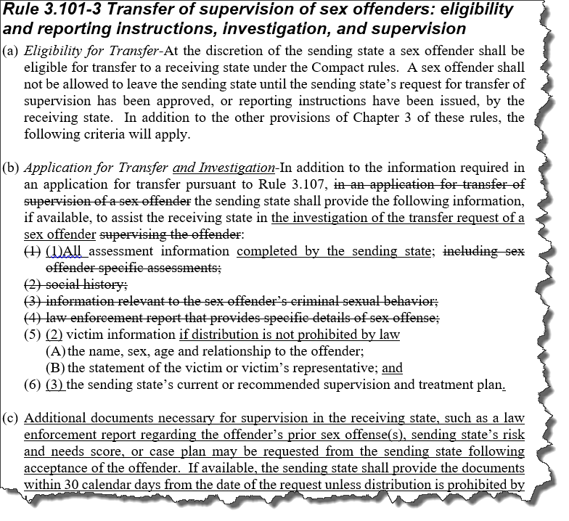
Sex Offender Rule Package Proposal

Slide 37
Proposal includes Rules:
1.101 ‘Sex Offender’
3.101-3
3.107 (minor clean-up)
Addresses issues identified through region/committee discussions over last 2 years
IMPACT
ICOTS: $27,150
Rule/Opinion: None
Rule Committee Action
Recommends to Adopt
Sex Offender Rule Package Proposal

Slide 38
Definition of ‘Sex Offender’
Addresses misinterpretations for responsibilities during transfer process
Does NOT limit receiving state’s ability to require registration
Sex Offender Rule Package Proposal

Slide 39
Rule 3.101-3
Distinguishes various compact process requirements eliminating delays:
Transfer Request-Defines info needed for investigation
Removes undefined/vague terms
Reporting Instructions-Defines info needed when eligible for RIs
No travel w/o Ris & 5 days to review residence (as indicated in existing rule)
Ensures denials (due to invalid residences) are consistent with similar offenders convicted in the receiving state
Supervision documentation-Similar to Rule 3.107 (c)
Sex Offender Rule Package Proposal

Slide 40
Sex Offender Transfer Considerations
Ensure conditions/housing restrictions are consistent with instate offenders
Would a similar instate offender be allowed to live @ residence?
Sex offender treatment
Sending States-be clear on recommendations
Receiving States-Ensure resources are the same for similar instate offenders
Packingham v. NC (2017 US Supreme Court decision)
NC law prohibiting sex offenders from accessing social media websites violates 1st amendment rights
Notes:
This slide is intended to lead into supervision in RS session scheduled for after lunch. It will further look at GPS, Marijuana, Dual supervision, etc.

Slide 41
Questions

