Slide 1
The Prescription Opioid and Heroin Crisis
Dr. Rachel L. Levine
Acting Secretary of Health
and Physician General
Professor of Pediatrics and Psychiatry
Penn State College of Medicine

Slide 2
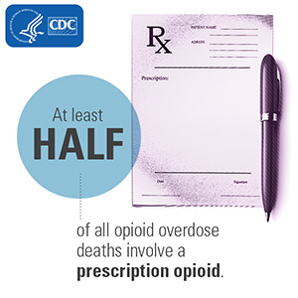
Heroin and Prescription Opioid Overdose Crisis
Overdose deaths from heroin and prescription drug abuse pose a public health crisis.
In 2016, 4,642 drug-related overdose deaths were reported in Pennsylvania - an increase of 37% from 2015

Slide 3

Heroin and Prescription Opioid Overdose Crisis
Up to 13 Pennsylvanians a day die of drug overdose
More Americans now die every year from drug overdoses than they do from motor vehicle crashes.

Slide 4
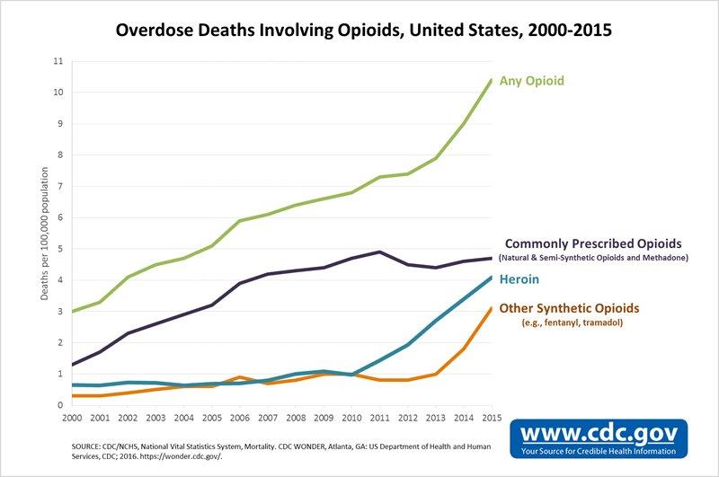
Heroin and Prescription Opioid Overdose Crisis
Drug overdose deaths* involving opioids, by type of opioid — United States, 2000–2015
Any Opioid
Commonly prescribed opioids
Heroin
Other Synthetic opioids

Slide 5
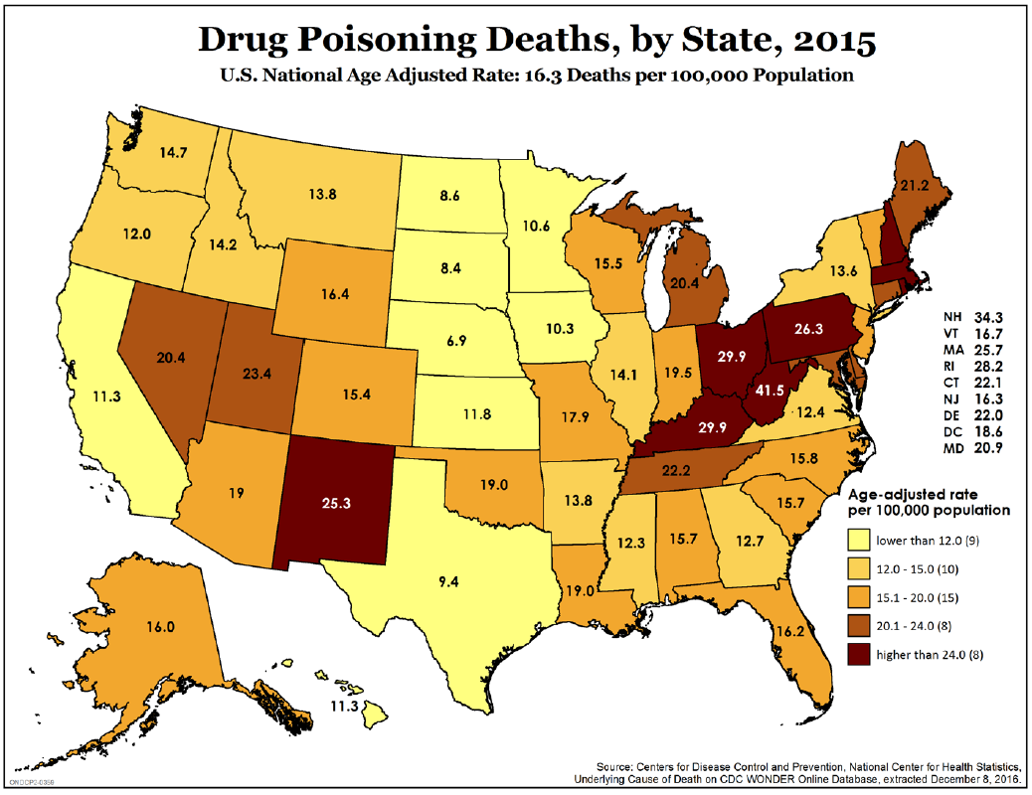
Heroin and Prescription Opioid Overdose Crisis
U.S. National Rate
16.3 Deaths per 100,000
Pennsylvania 2016 Rate
36.54 Deaths per 100,000

Slide 6
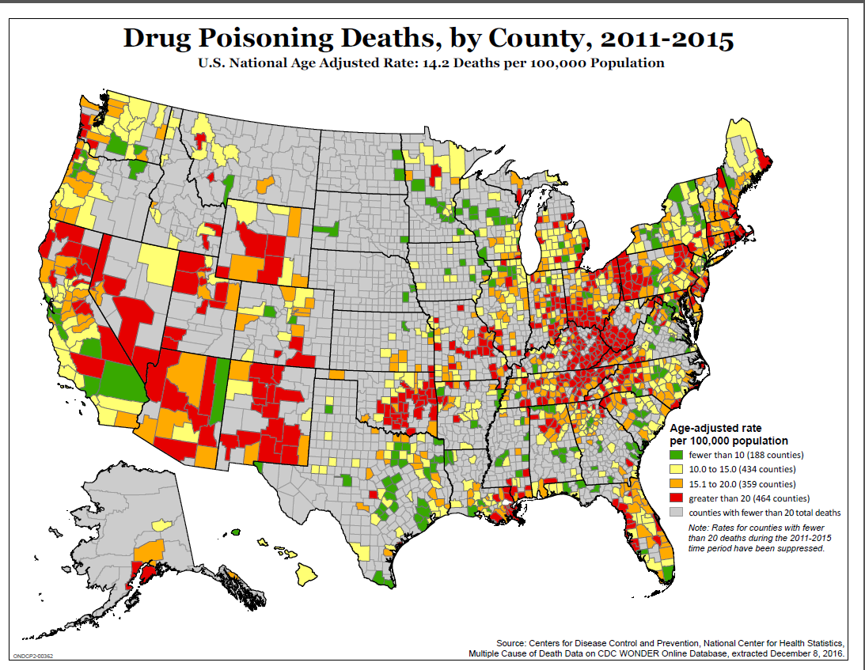
Heroin and Prescription Opioid Overdose Crisis
Rate Greater than 20 Deaths per 100,000
Counties with Fewer than 20 total deaths

Slide 7
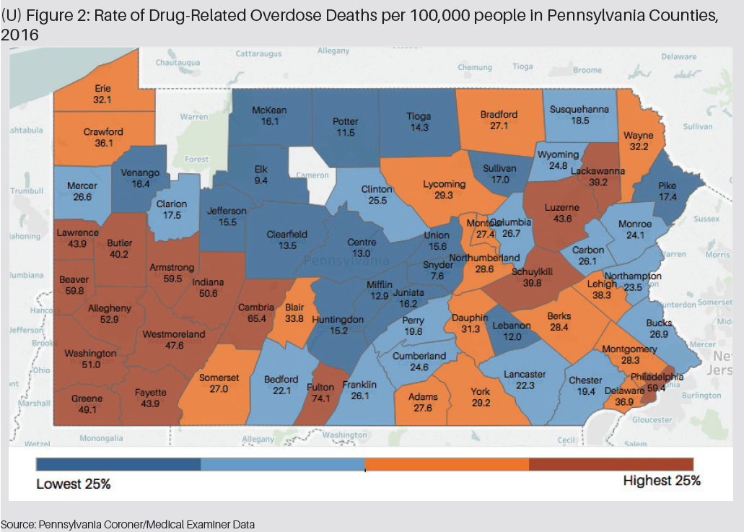
Heroin and Prescription Opioid Overdose Crisis
Rate in urban county of Philadelphia is 59.4 per 100,000
Rate in rural Fulton county is 74.1 per 100,000
Source: DEA Intelligence Report, Analysis of Drug-Related Overdose Deaths in Pennsylvania 2016

Slide 8
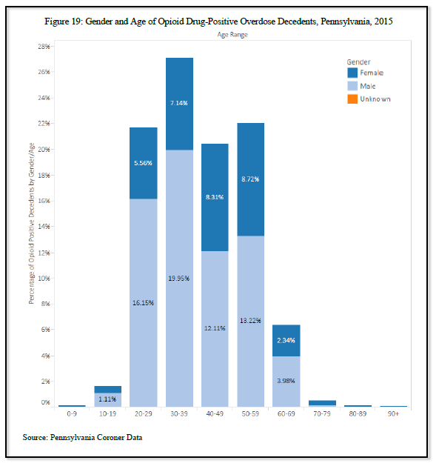
Heroin and Prescription Opioid Overdose Crisis
In PA white males in the 30-39 age range were the most at risk demographic group for opioid overdose.
Overdoses reported in all age groups including those over 90 years of age.
Source: DEA Intelligence Report, Analysis of Drug-Related Overdose Deaths in Pennsylvania 2015

Slide 9
Heroin and Prescription Opioid Overdose Crisis
Addiction is a chronic relapsing brain disease
Three stage circuit change- Dopamine Pathways
      Reward
      Stress response
      Decision making
      Brain changes can persist long after substance use ends
      Adolescent brain at increase risk

Slide 10
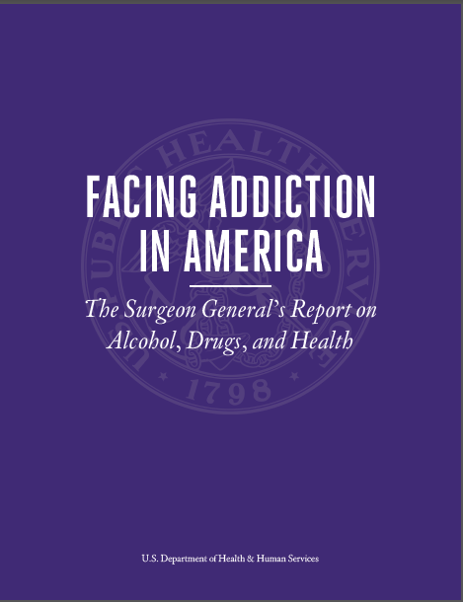
Surgeon General’s Report
Released November 17, 2016
The first ever Surgeon General’s Report on Addiction

Slide 11
Heroin and Prescription Opioid Overdose Crisis
80% of heroin users started with prescription opioids
4-7% of those who misuse opioids will begin to use heroin

Slide 12
Heroin and Prescription Opioid Overdose Crisis
Relationship between Nonmedical Prescription Opioid Use and Heroin Use, Compton et al, New England Journal of Medicine, 2016, 374:154-63

Slide 13
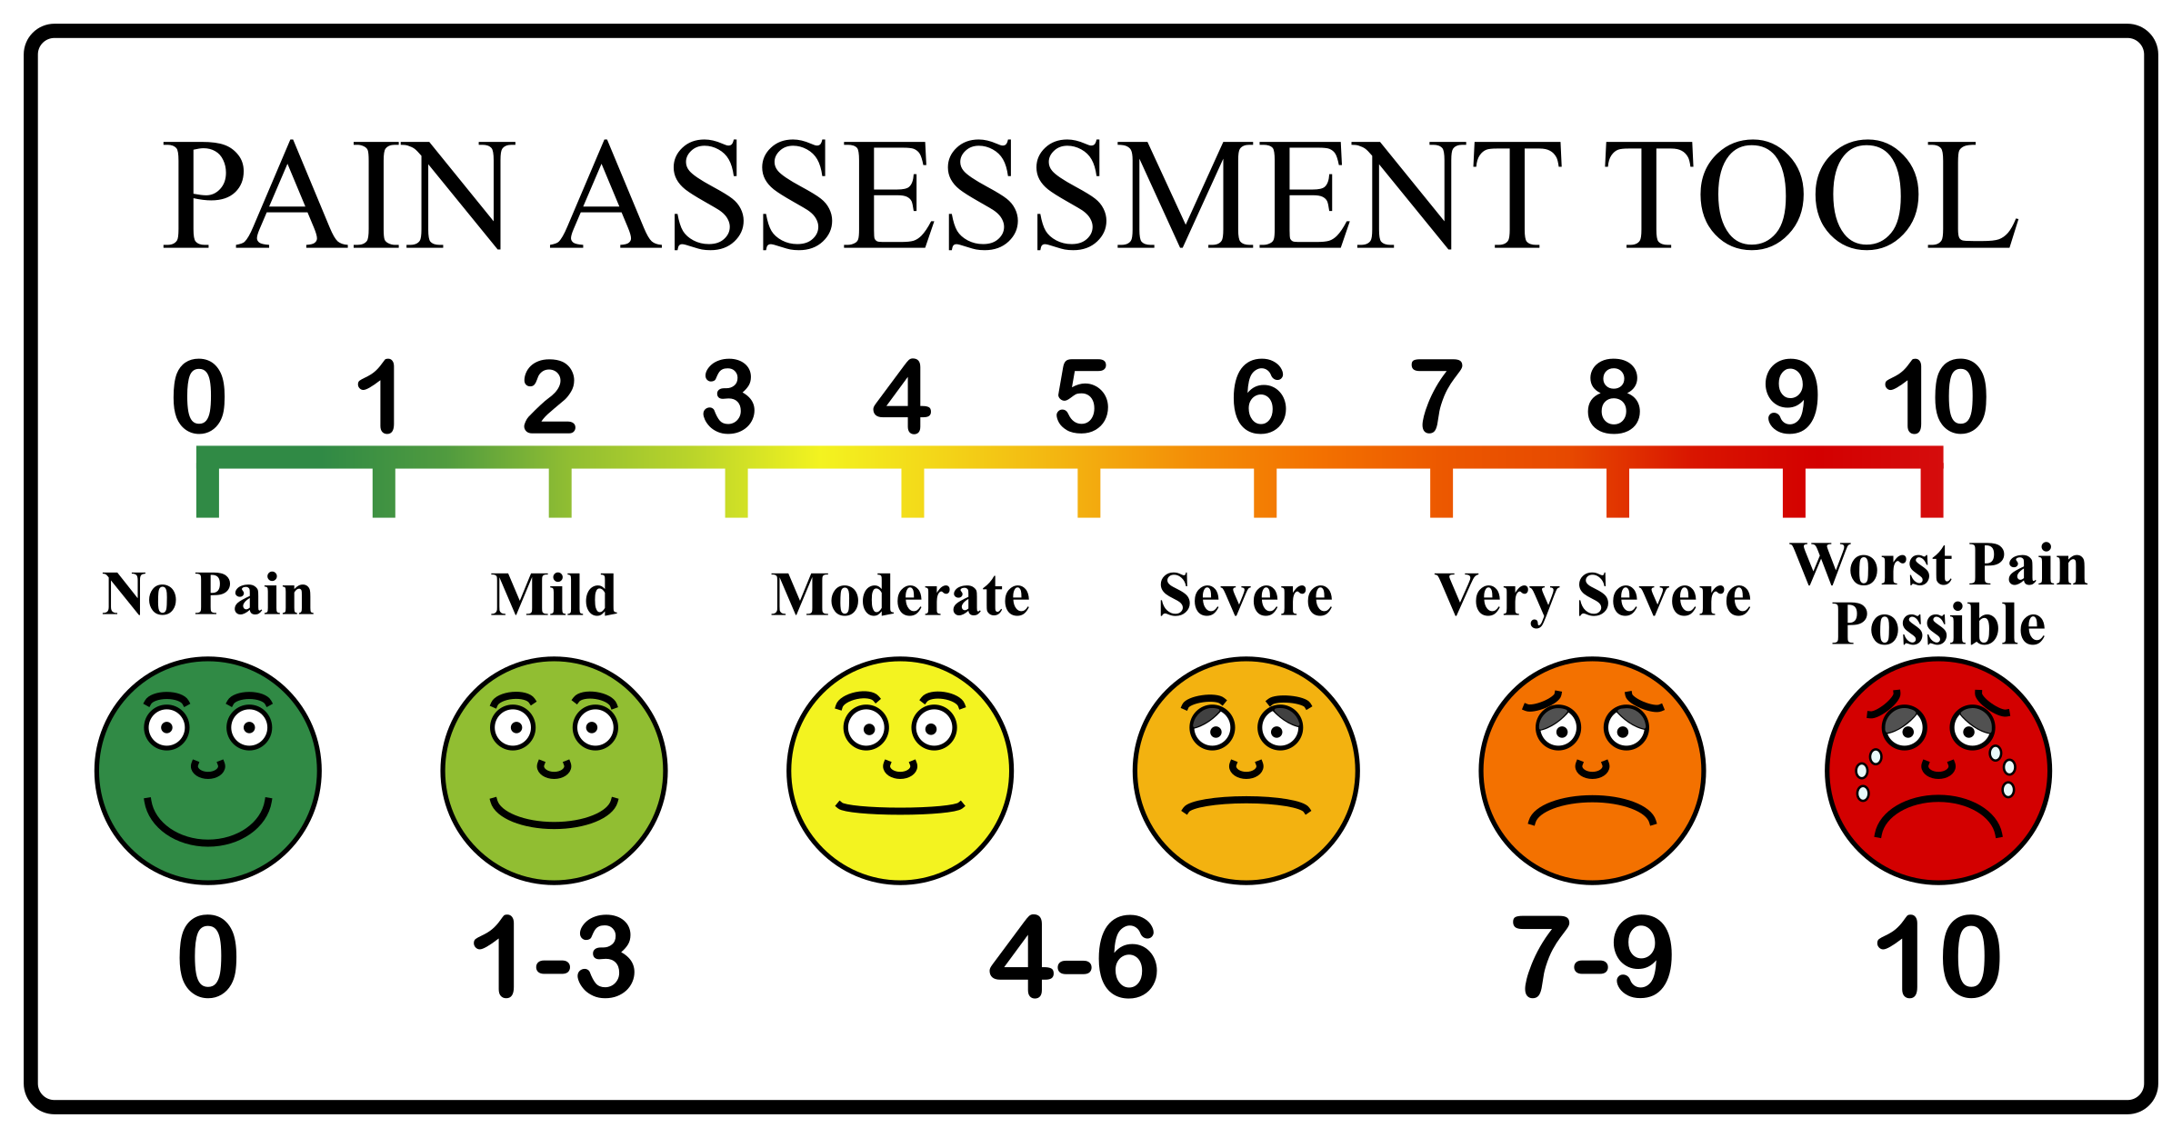
Heroin and Prescription Opioid Overdose Crisis
How did we get here?
1990s - increased emphasis on the identification of pain

Slide 14

Heroin and Prescription Opioid Overdose Crisis
How did we get here?
Since 1999, the amount of prescription opioids sold in the U.S. nearly quadrupled.
Health care providers wrote 259 million prescriptions for painkillers in 2012, enough for every American adult to have a bottle of pills.
80 percent of heroin users report nonmedical use of prescription opioids.

Slide 15
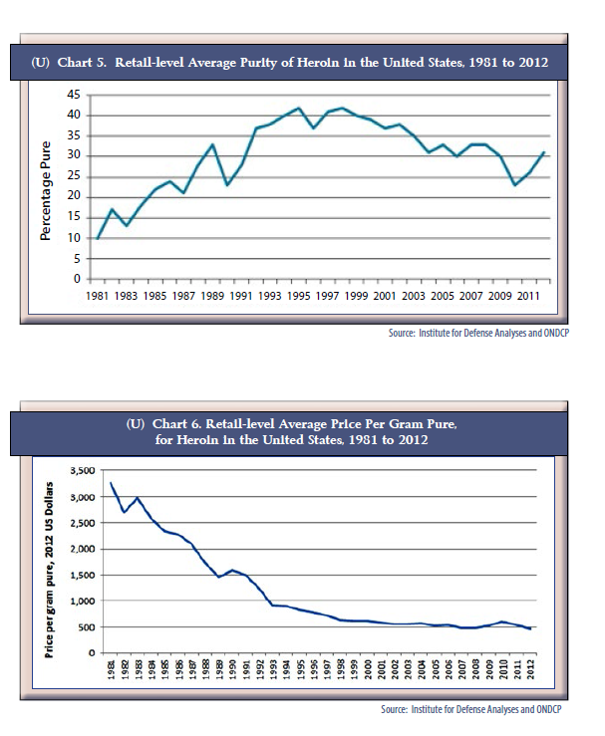
Heroin and Prescription Opioid Overdose Crisis
How did we get here?
At the same time heroin availability is increasing throughout the nation.
Heroin seizures in the United States increased 80 percent over five years from 2011 to 2015
Heroin today is much higher purity and lower price
Purity
Price

Slide 16
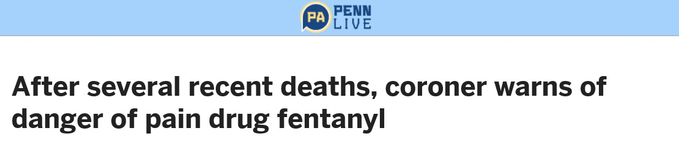
Heroin and Prescription Opioid Overdose Crisis
How did we get here?
Fentanyl has played an increasing role in overdose deaths since 2013.
51% of opioid overdose deaths indicated the presence of fentanyl.
Fentanyl increasingly disguised as prescription pills.
Carfentanil – a new emerging substance

Slide 17
Heroin and Prescription Opioid Overdose Crisis
Frank, R. G., & Pollack, H. A. (2017). Addressing the Fentanyl Threat to Public Health. New England Journal of Medicine, 376(7), 605-607.
“Fentanyl’s low production costs and high death toll pose a distinctive challenge that requires a concerted response.”

Slide 18

State’s Response
Commonwealth’s response
  Opioid Stewardship
  Work with medical schools on education of students
  Provider education through continuing education credits

Slide 19
Work with Medical Schools
Pennsylvania State Core Competencies for Education on Opioids and Addiction, Ashburn, Levine, Pain Medicine 2017.
Task force of Deans/Associate Deans of the medical schools and osteopathic medical schools in the state

Slide 20
Work with Medical Schools
Core Competencies:
  Understanding core aspects of addiction
  Patient screening for SUD
  Proper referral for evaluation and treatment of SUD
  Proper patient assessment when treating pain
  Proper use of multimodal treatment options when treating acute pain

Slide 21
Work with Medical Schools
Core competencies- continued
  Proper use of opioids for treating acute pain
  The role of opioids in treatment of chronic non-cancer pain
  Patient risk assessment for SUD for use of opioids to treat chronic non-cancer pain
  Process of patient education, initiation of treatment, patient monitoring and discontinuation of therapy of opioids to treat chronic noncancer pain.

Slide 22
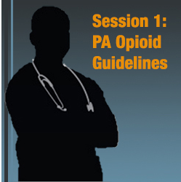
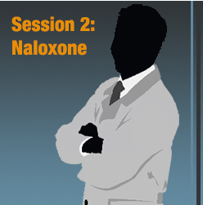
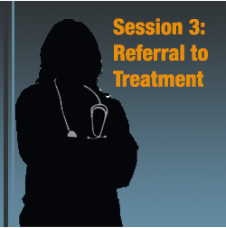
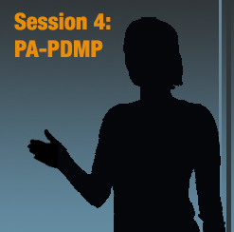
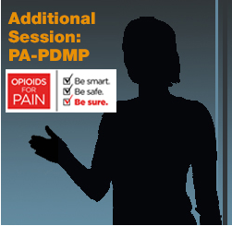
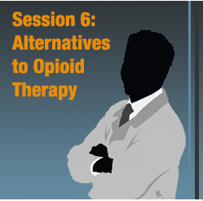
Continuing Education

Slide 23

Heroin and Prescription Opioid Overdose Crisis
Commonwealth’s response
  Opioid Prescribing guidelines
    Pediatric and Adolescent Populations
    Emergency departments
    Dentists
    Chronic non-cancer pain
    Geriatric providers
    Pharmacists
    Obstetrics and gynecology
    Treatment of Substance Use Disorder in Pregnant Patients
    Benzodiazepines
    Orthopedics and Sports Medicine

Slide 24
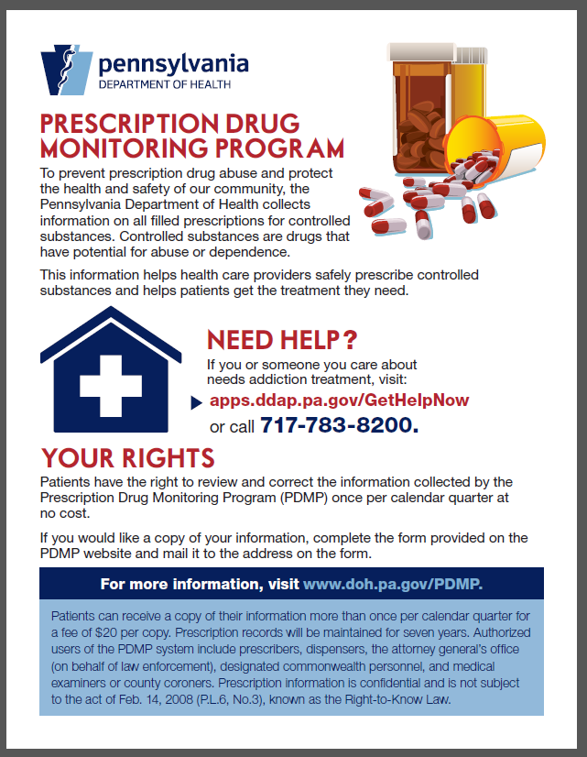
Heroin and Prescription Opioid Overdose Crisis
Commonwealth’s response
Prescription Drug Monitoring Program (PDMP)
Critical online tool to support clinicians in identifying patients who may be struggling from the disease of addiction and help connect them with treatment services

Slide 25
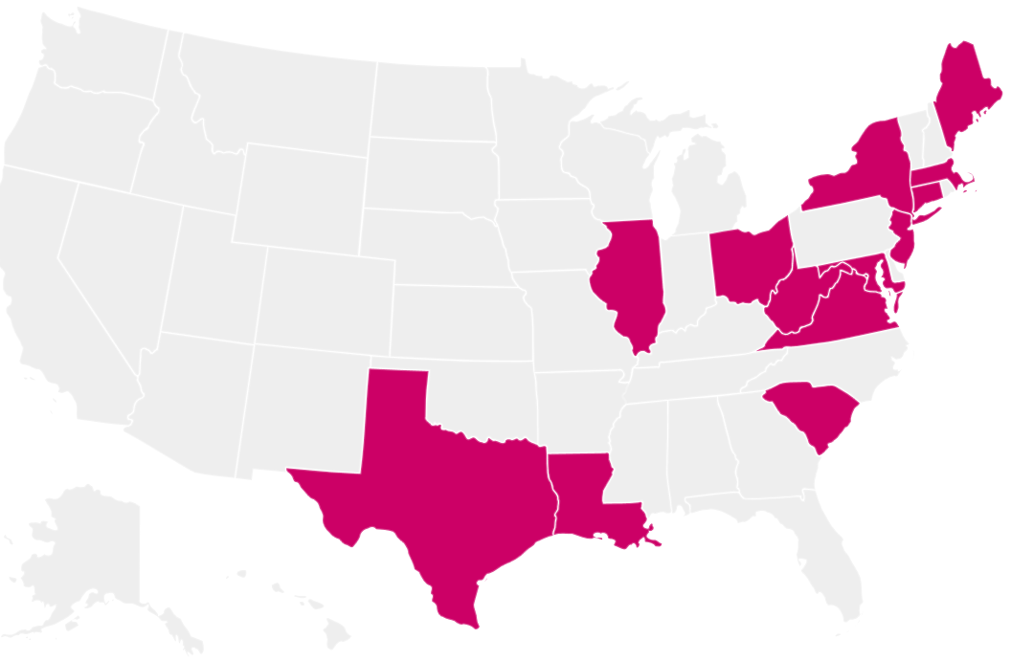
Heroin and Prescription Opioid Overdose Crisis
  Commonwealth’s response
  94,655 registered users of the PDMP since August 2016
  Average patient searches: 52,000/weekday and 9,000/weekend
  Interstate data sharing with 13 states and Washington D.C (including one-way sharing with MD)

Slide 26
Heroin and Prescription Opioid Overdose Crisis
From July 2016 to June 2017
PDMP Success Measures Doctor Shopping from Q1 FY16/17 to Q4 FY16/17
Drug Type Prescribed | % Change in People accessing 5+ prescribers, 5+ pharmacies | % Change in People accessing 10+ prescribers, 10+ pharmacies
Schedule II | 86% | 100%
Schedule II and/or III | 84% | 100%
Schedule II, III and/or IV | 74% | 97%
Number of youth who received prescriptions for painkillers with a morphine milligram equivalent (MME) greater than 100 mg per day – decreased by 30%

Slide 27

Heroin and Prescription Opioid Overdose Crisis
Commonwealth’s response
The Pennsylvania Prescription Drug Take-Back Program
The Pennsylvania Commission on Crime and Delinquency awarded grants to District Attorney’s to Pennsylvania counties for permanent drug take-back boxes.

Slide 28
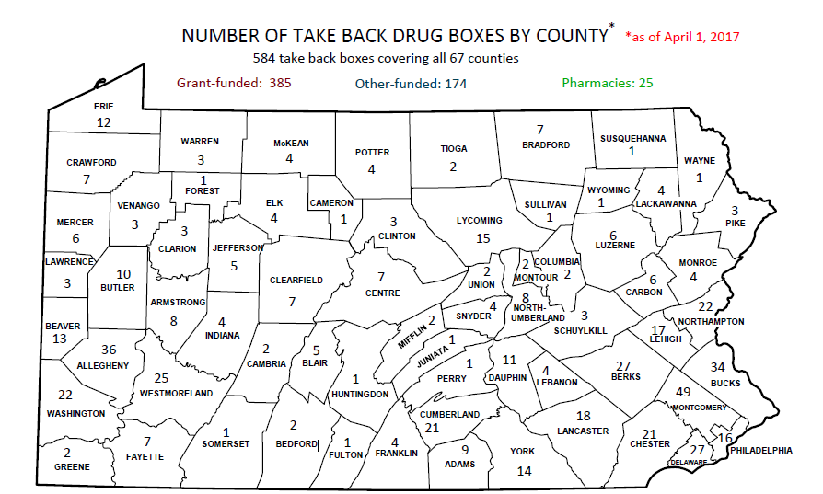
Heroin and Prescription Opioid Overdose Crisis
Heroin and Prescription Opioid Overdose Crisis
Commonwealth’s response
  679 Prescription Drug Take Back Boxes throughout Pennsylvania
  To find a Location: https://apps.ddap.pa.gov/GetHelpNow/PillDrop.aspx

Slide 29
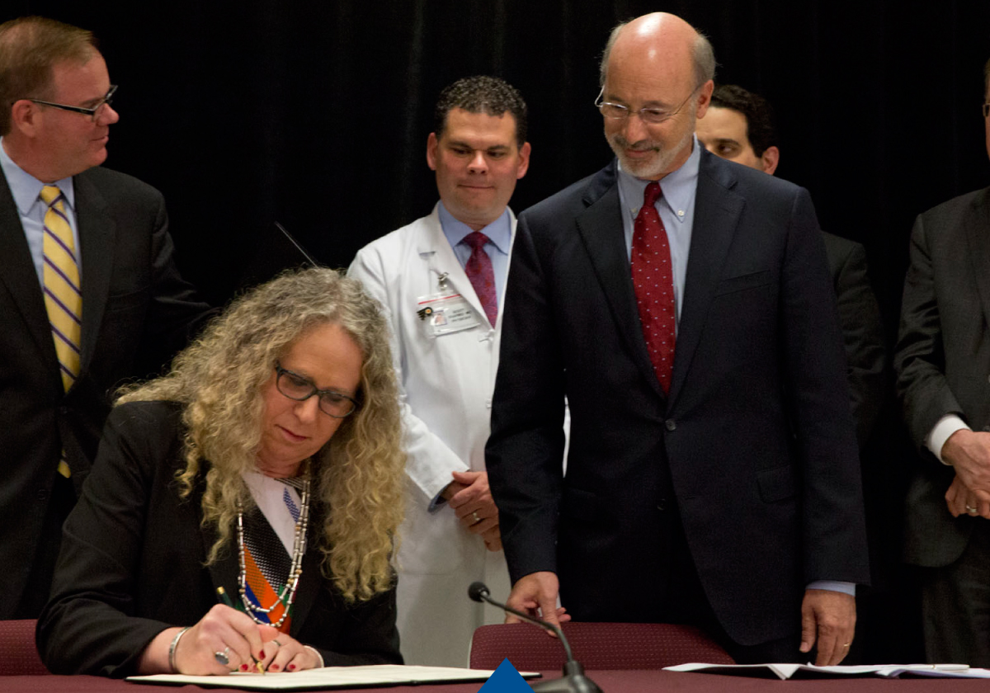
Heroin and Prescription Opioid Overdose Crisis
Commonwealth’s response
Expand naloxone access
Naloxone - safe and effective
Standing order for first responders
Standing order for general public
Support for public schools to have naloxone on-site
Additional $5 million in Governor’s Budget for naloxone

Slide 30
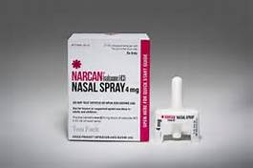
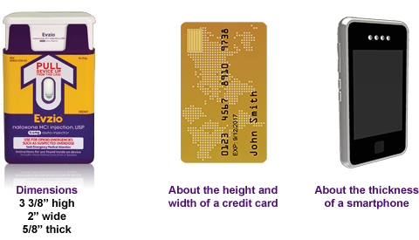
Heroin and Prescription Opioid Overdose Crisis
naloxone nasal spray
Prefilled medication tube and an atomization device
auto-injector

Slide 31
Naloxone Reversals By Police Officers In Opioid Overdose Events
Full County Coverage
Number of successful overdose reversals per county
Partial Coverage
TOTAL POLICE REVERSALS = 3,988
Preparing to launch
Municipal Police Reversals = 3,878
PA State Police Reversals = 110
Estimated Population Covered = 9,499 million (74%)
Erie
110
Warren
McKean
Tioga
Susquehanna
Crawford
1
2
Potter
0
Bradford
0
Wayne
0
0
1
**
Forest
Wyoming
Elk
Cameron
**
1
Lackawanna
Venango
5
0
Lycoming
Sullivan
73
Mercer
Clinton
Pike
18
Clarion
1
Luzerne
1
0
Jefferson
Columbia
41
Lawrence
10
Clearfield
Union
Montour
10
Monroe
Butler
4
Centre
0
Carbon
0
37
10
Northumberland
23
Armstrong
Snyder
9
Beaver
0
Northampton
1
13
Indiana
Schuylkill
Lehigh
106
22
Mifflin
**
18
60
Allegheny
Cambria
Blair
0
0
Juniata
Dauphin
221
5
16
4
Berks
Perry
91
Lebanon
43
Bucks
Westmoreland
22
263
Washington
57
Huntingdon
Montgomery
155
Cumberland
411
105
Lancaster
Fulton
York
184
Chester
Fayette
Somerset
Bedford
**
Franklin
Adams
520
187
545
Philadelphia
Greene
1
0
0
57
20
393
0
Delaware
Double asterisks ** signify counties that do not have municipal police departments and are only covered by the PA State Police
Rev 09/25/2017

Slide 32
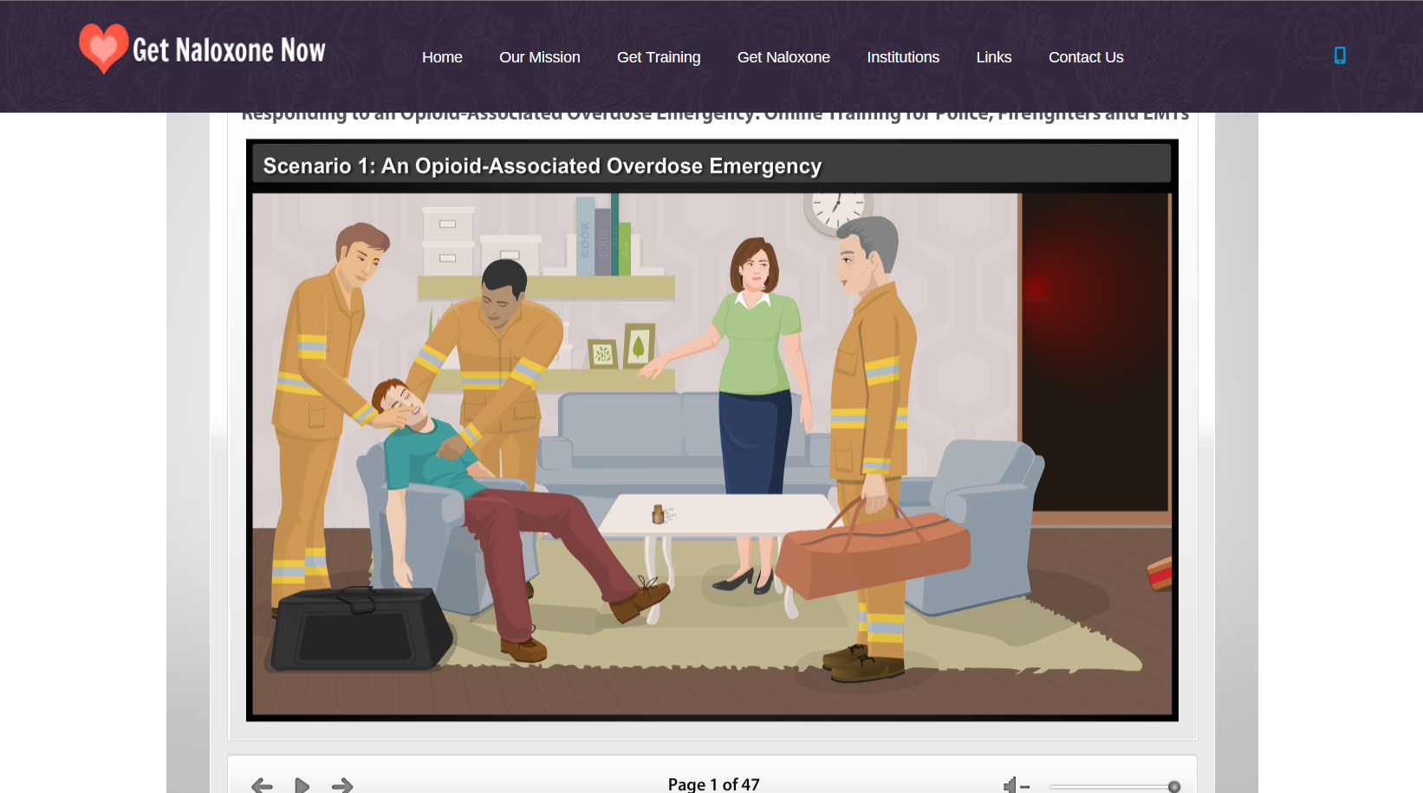
Heroin and Prescription Opioid Overdose Crisis
Free trainings are available at
www.getnaloxonenow.org or www.pavtn.net/act-139-training

Slide 33
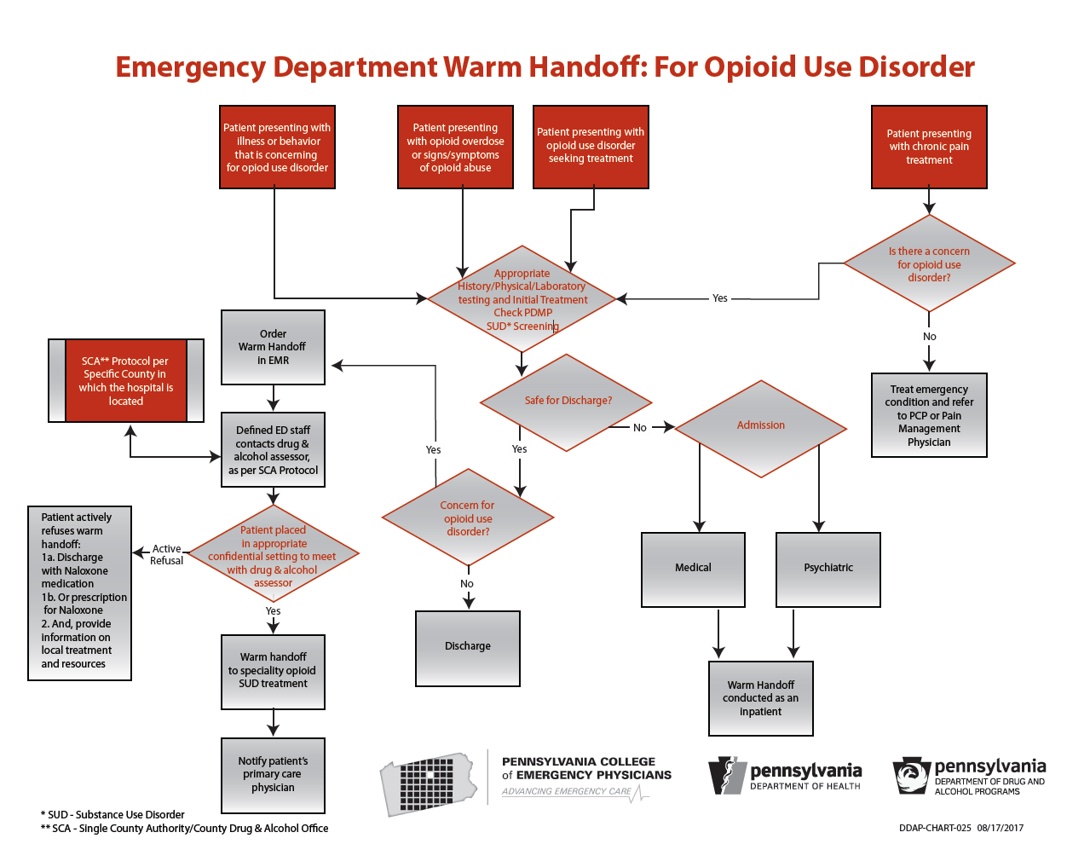
Heroin and Prescription Opioid Overdose Crisis
Commonwealth’s Response
  Focus on
  ‘warm hand off’
  to treatment

Slide 34
Heroin and Prescription Opioid Overdose Crisis
Heroin and Prescription Opioid Overdose Crisis
Commonwealth’s response
  Drug and Alcohol Treatment Services Hotline
  1-800-662-4357 (HELP)

Slide 35
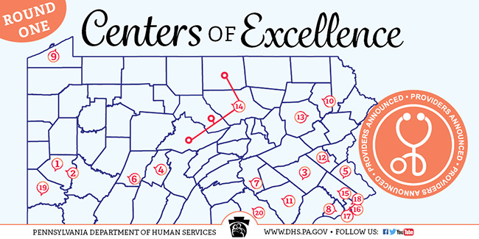

Heroin and Prescription Opioid Overdose Crisis
Commonwealth’s response
  Treatment with an emphasis on medication-assisted treatment
    45 new Centers of Excellence will open statewide

Slide 36
Heroin and Prescription Opioid Overdose Crisis
Commonwealth’s response
Secured 21st Century Cures Grant
A $26.5 Million Federal Grant

Slide 37
Heroin and Prescription Opioid Overdose Crisis
Commonwealth’s response
Pa Coordinated Medication Assisted Treatment (Pac/Mat)
Provide clinically appropriate treatment services to 6,000 individuals who are uninsured or underinsured.
Expand treatment capacity for Medication Assisted Treatment for OUD.
Expand treatment capacity for underserved populations by targeted workforce development and cultural competency training.

Slide 38
Pac/MAT
Pa Coordinated Medication Assisted Treatment
Hub & Spoke model
At the Hub would be an addiction specialist physician-lead team.
The Hub would network with primary care physicians in rural and underserved areas of the state who would serve as the Spokes.
The primary care physicians would provide the direct patient care including the MAT prescription.
All patients would also receive therapy services
Coordinate with SCAs

Slide 39
Pac/MAT
The Hub would provide all the following services:
Policies and procedures for primary care physicians
As consulting physicians on new patients,
As consulting physicians for complex patients,
Clinical education,
Technical support,
Case management,
Outcomes and quality measurements
Provide referral and coordinate care with pain medicine and mental health
As necessary, direct treatment for patients through an office visit and/or telemedicine.

Slide 40
Pac/MAT
Financing
Is flexible
Primary care providers would be paid fee-for-service for each patient
Addiction specialty hub could be paid a risk adjusted capitated per patient per month fee for all patients in the network
Addiction specialty hub would be paid a fee for service for direct patient care
Savings in increased patient outcomes and reduction on inpatient rehab.

Slide 41
Pac/MAT
Drug and Alcohol counselor
Primary Care Physician
Drug and Alcohol counselor
Primary Care Physician
Primary Care Physician
Primary Care Physician
Community Psychiatrist
Primary Care Physician
Addiction Medicine
Specialist
Team
Pain Management
Family Physician
Mental Health
Drug and Alcohol counselor
Primary Care Physician
Drug and Alcohol counselor

Slide 42
Questions?
@PhysGenLevine

